Slide 1
Network structure and money flow as drivers of conspiracy thinking
Gent Serifi, Anja Sjöström, Jose Luis Ocana Pujol, Christopher Witzany
05.12.2022

Slide 2
Table of Contents
Some background on conspiracy theories → research question
Our model
Preliminary results
Outlook, further work, and considerations

Slide 3
Some background on conspiracy theories

Slide 4

We can access more data than ever
The data availability paradox
Conspiracy theories are more popular than ever

Slide 5
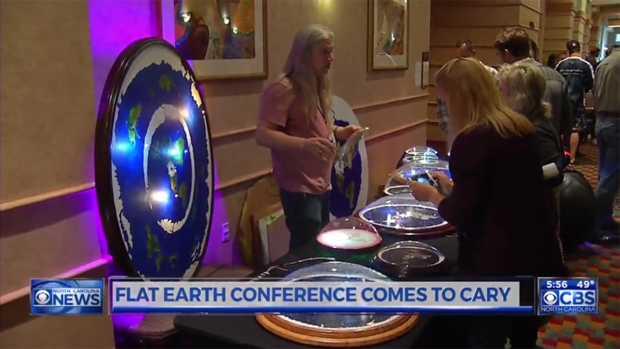

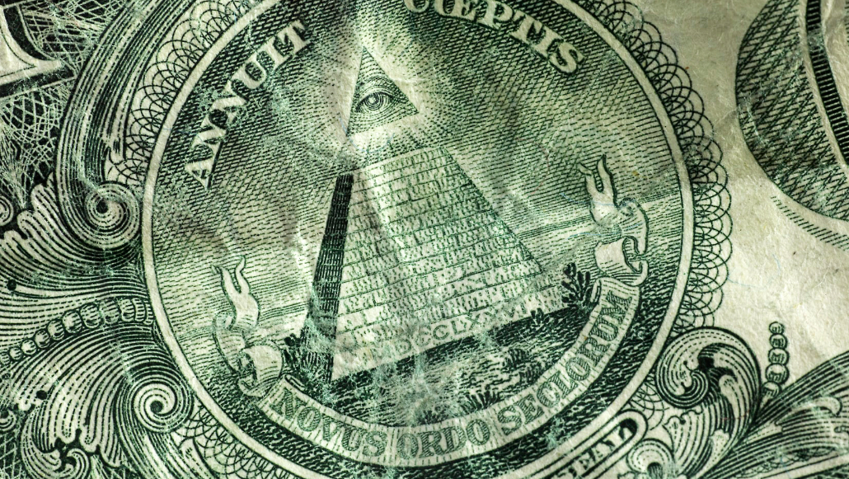

Examples of popular conspiracy theories

Slide 6
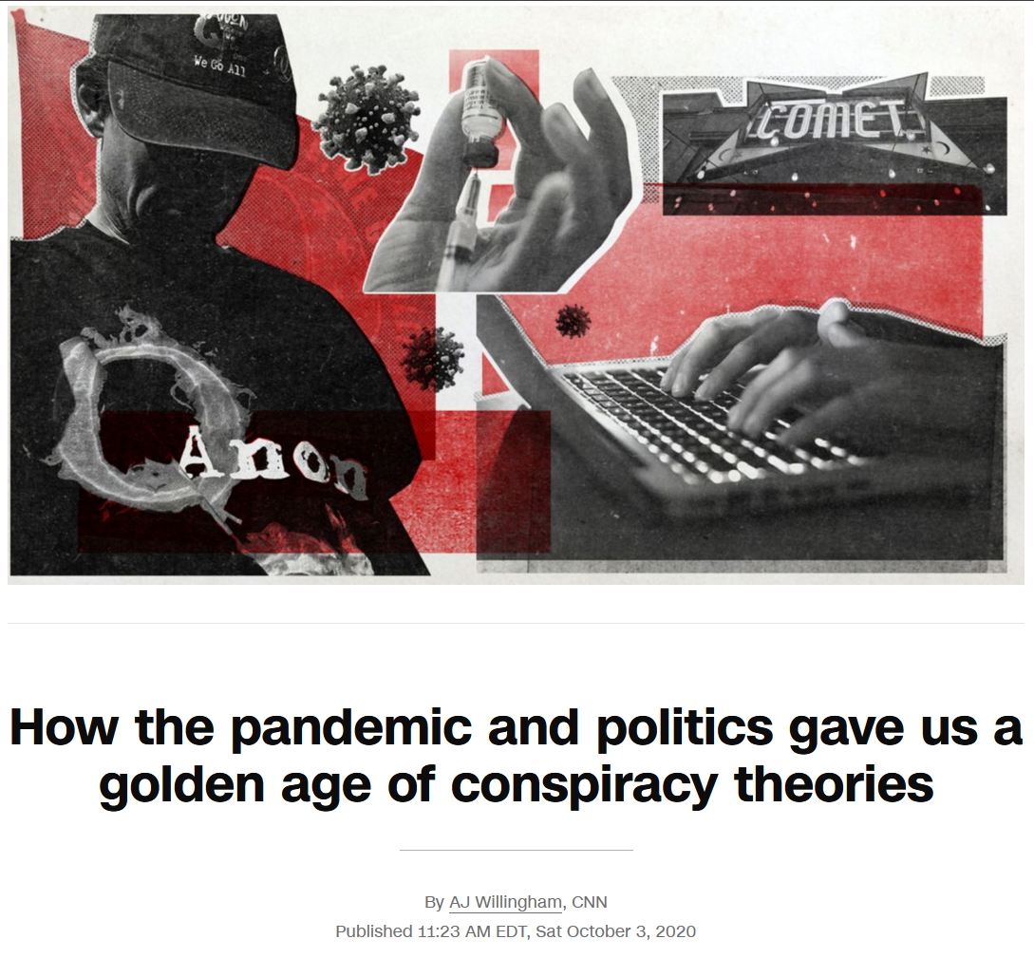



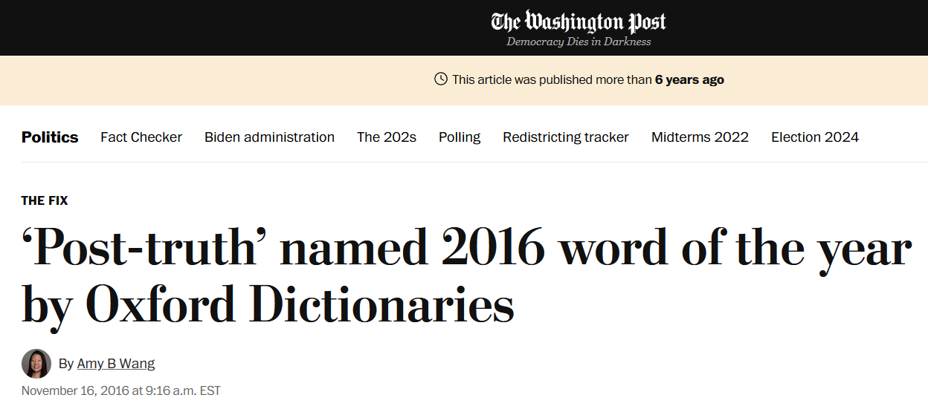
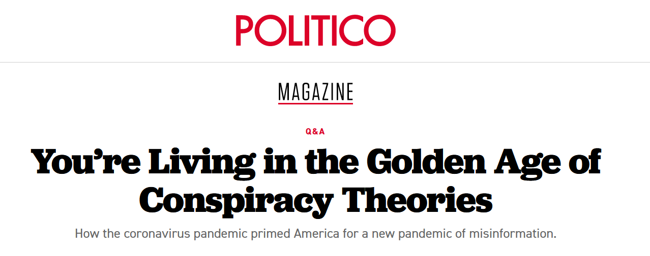
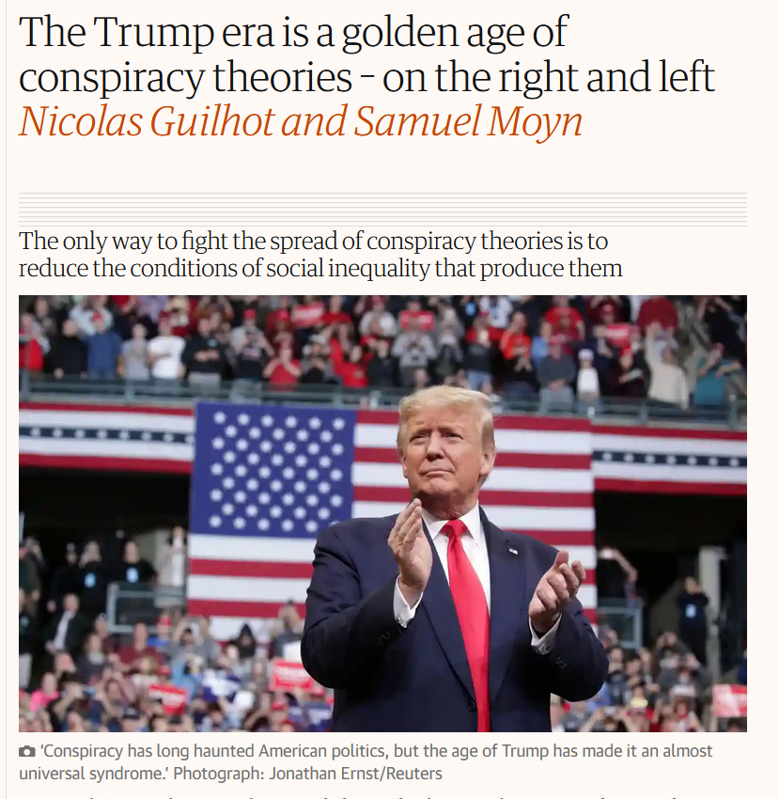
We are in the golden age of conspiracy theories

Slide 7
Are we?

Slide 8
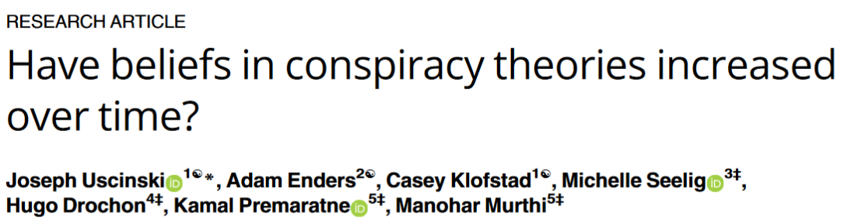
“The public is convinced that beliefs in conspiracy theories are increasing, and many scholars, journalists, and policymakers agree.”
“In no instance do we observe systematic evidence for an increase in conspiracism, however operationalized.”
4 studies

Slide 9
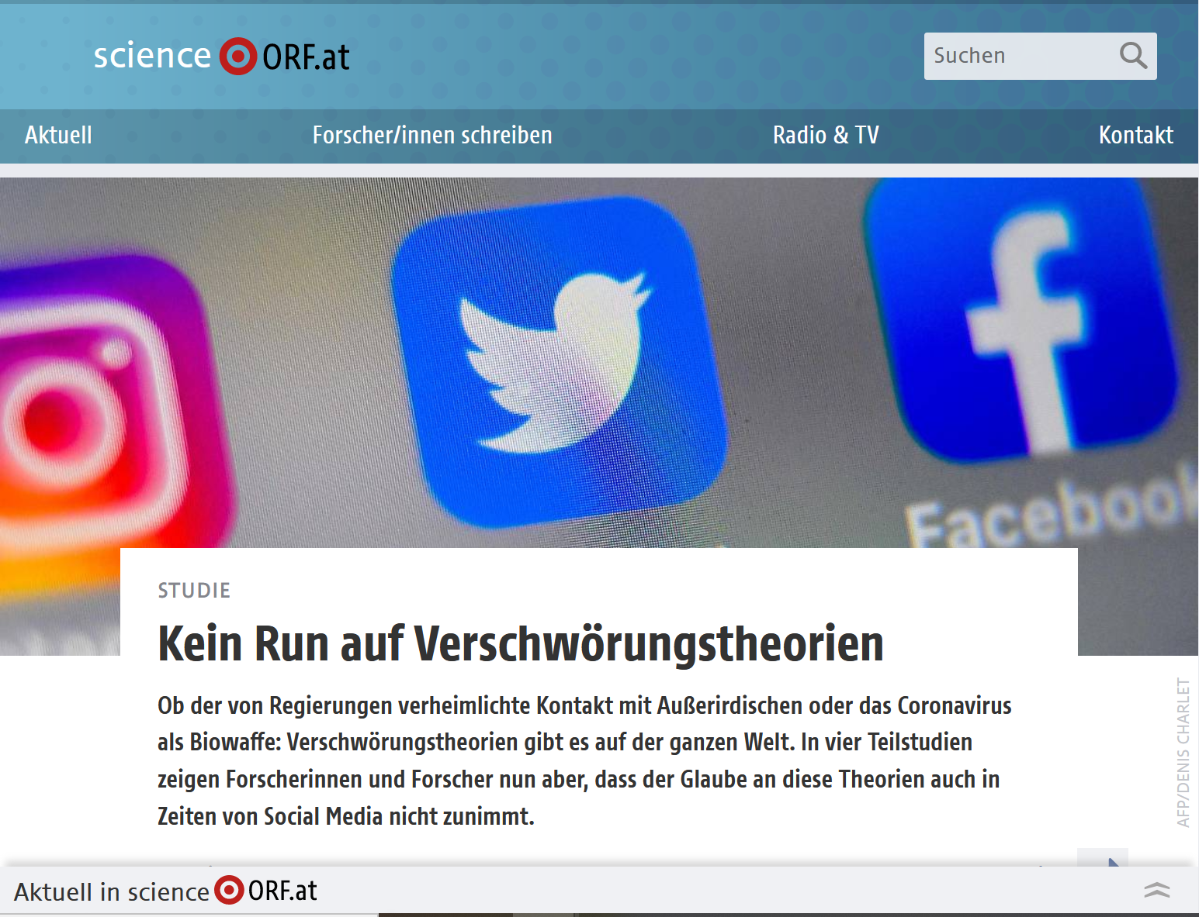
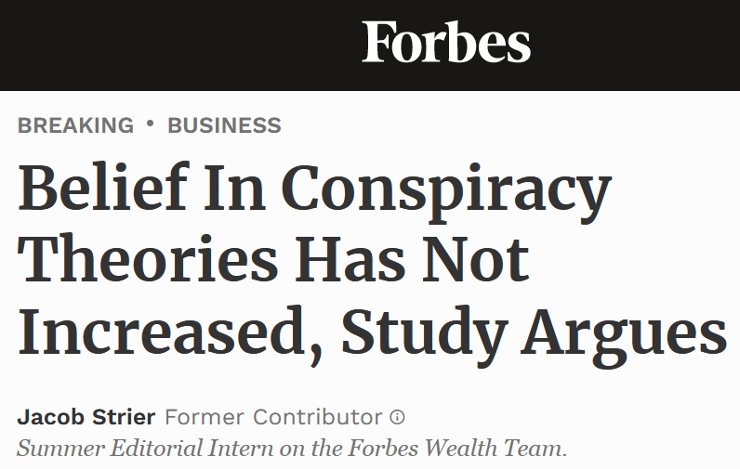

Slide 10
Limitations of the study
Many “political” conspiracy theories analyzed: do people still care about who killed Kennedy?
Studies 2,3 and 4: Oldest data point 2012.
Study 1: popularity conspiracy theories compared over different amounts of time (from 6 months to 55 years):
Mean 12 years
Median 8 years Most data after 2010.
Std Dev Mean>Mean!

Slide 11
Variety in the age of conspiracy theories
Notes:
The same conspiracy theories that i introduced bf vary greatly in how long theyve been around

Slide 12
Variety in the age of conspiracy theories
Notes:
Qanon since 2017, covid obviously even more recent

Slide 13
Variety in the age of conspiracy theories
Notes:
This two are centuries old (flat earth/iluminati)

Slide 14
Case study: Flat Earth
Notes:
This two are centuries old (flat earth/iluminati)

Slide 15
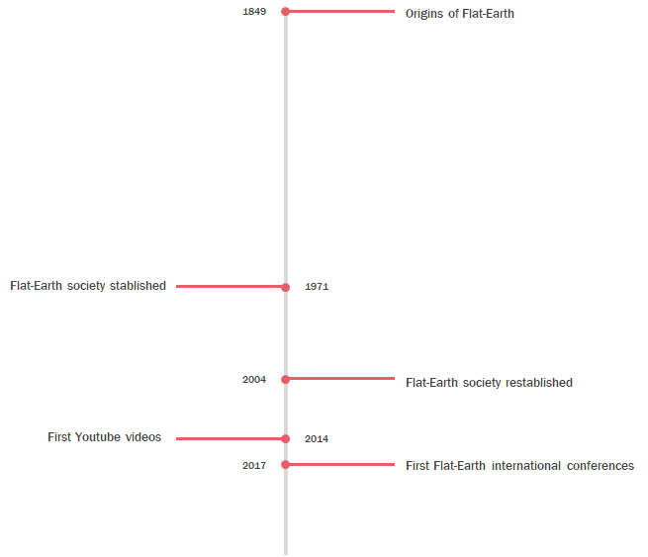
Case study: Flat Earth
Timeline^{1,2}: long history.
1 Olshansky, A.; Peaslee, R. M.; Landrum, A. R. Flat-Smacked! Converting to Flat Eartherism. Journal of Media and Religion 2020, 19 (2), 46–59. https://doi.org/10.1080/15348423.2020.1774257.
2 Paolillo, J. C. The Flat Earth Phenomenon on YouTube. First Monday 2018. https://doi.org/10.5210/fm.v23i12.8251.

Slide 16
Case study: Flat Earth
Timeline^{1,2}: long history.
Most people in Flat Earth Conferences converted recently by Youtube¹
Different demographics, more sensitive to science-based arguments²
1 Olshansky, A.; Peaslee, R. M.; Landrum, A. R. Flat-Smacked! Converting to Flat Eartherism. Journal of Media and Religion 2020, 19 (2), 46–59. https://doi.org/10.1080/15348423.2020.1774257.
2 Paolillo, J. C. The Flat Earth Phenomenon on YouTube. First Monday 2018. https://doi.org/10.5210/fm.v23i12.8251.

Slide 17
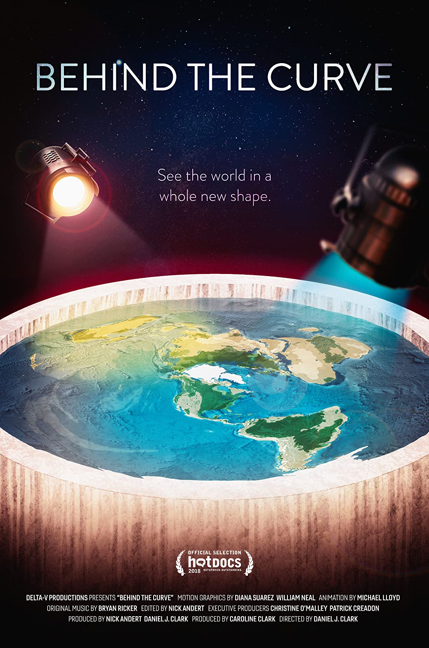
Why do we care?
Less popular than other science-related conspiracy theories (vaccines, moon landing...). 3-12% of western society¹.
Still, broad media attention: Netflix.
¹ 3 serious surveys (US and UK) compared. Anecdotal evidence from another 3 countries in the same range. More info in back up slides

Slide 18
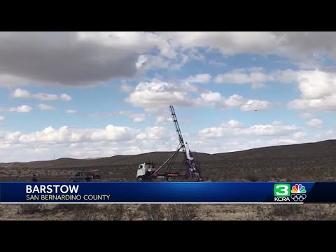
Why do we care?
Less popular than other science-related conspiracy theories (vaccines, moon landing...)
Still, broad media attention: Netflix.
Unlike other misinformation (eg. Vaccine hesitancy), it seems to be considered "innocent" and "laughable".

Slide 19
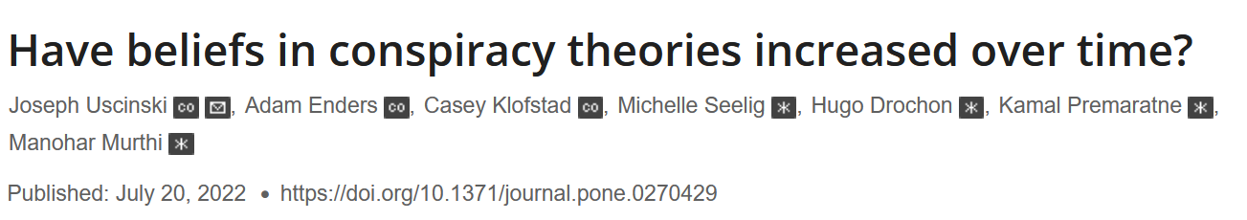
Summary of the introduction: gap
vs

Slide 20
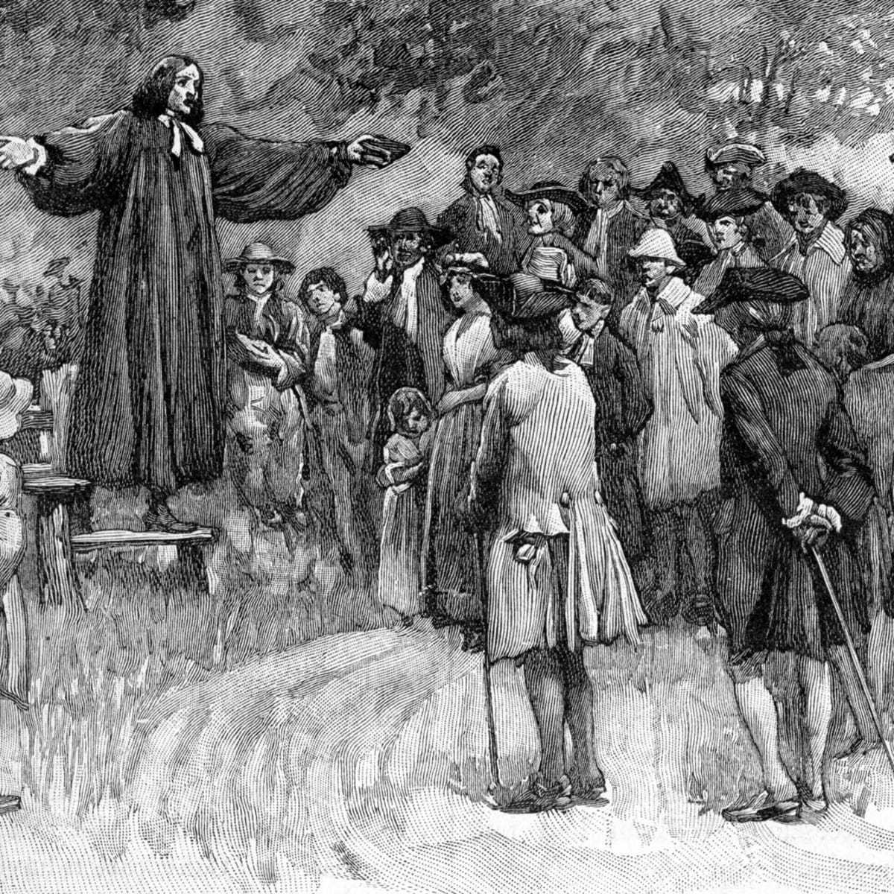
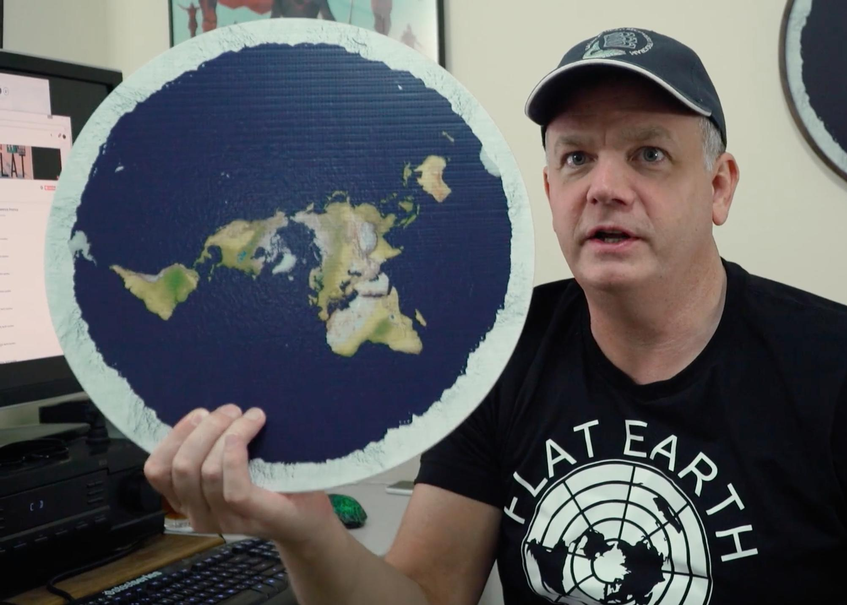
Summary of the introduction: gap
vs

Slide 21

Summary of the introduction: gap
?

Slide 22
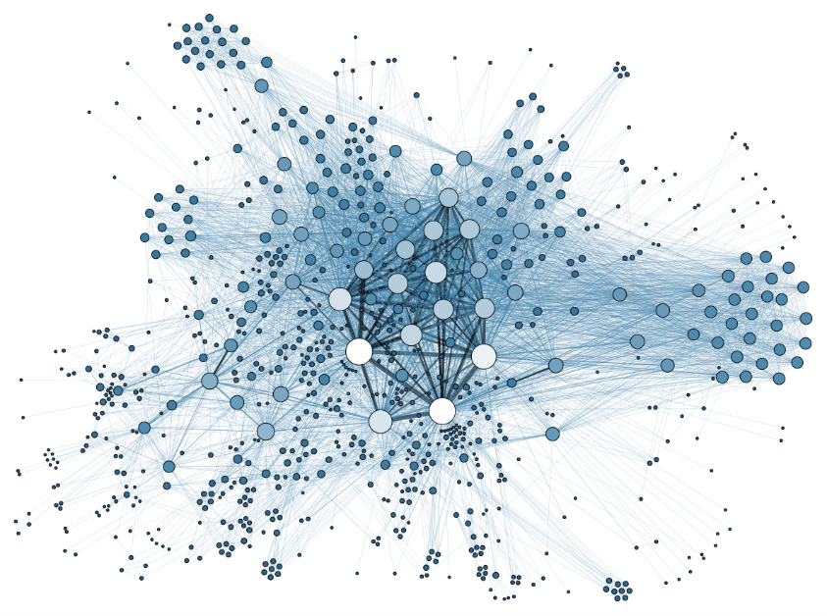
Research question: Is the topology of the network responsible for the increase in conspiracy thinking?

Slide 23
Our model

Slide 24
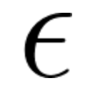
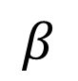
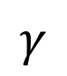
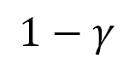
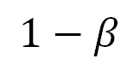
SEIZ-Model of Opinion Spread
4 possible opinion-states:
transitions:
Susceptible (never heard of it)
Exposed (heard of it, processing)
Infected (believes)
Zkeptic (does not believe)
I
$$β$$
$$1−β$$
S
E
$$1−γ$$
$$γ$$
Z
Jin et al., 2013

Slide 25
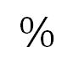
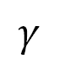
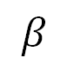
Modifications to the SEIZ-Model
4 possible opinion-states:
transitions:
Susceptible (never heard of it)
Exposed (heard of it, processing)
Infected (believes)
Zkeptic (does not believe)
I
$$β$$
$$β$$
$$1−β$$
S
E
$$\%$$
$$1−γ$$
$$γ$$
$$γ$$
Z

Slide 26
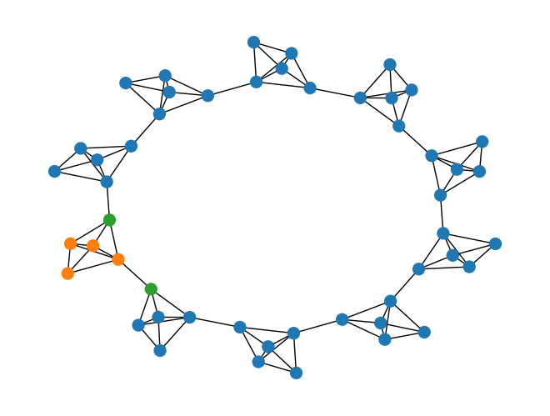
Agent based modelling
environment
agent
properties:
opinion (susceptible, exposed, skeptic, infected)
transitions:
Stochastic opinion change
susceptible: interact with 1 random neighbor
exposed: interact with 1 random neighbor or
transition randomly
skeptic to infected: locally influenced (vice versa)
Notes:
Make point about distinction between environment properties and agent properties.

Slide 27
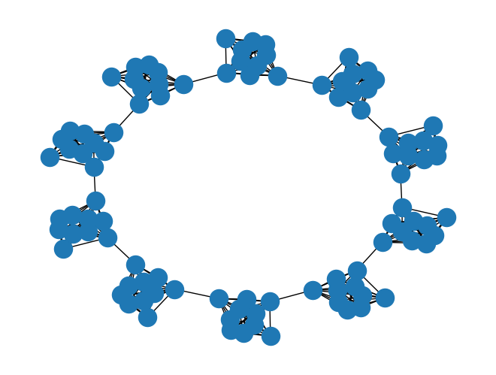
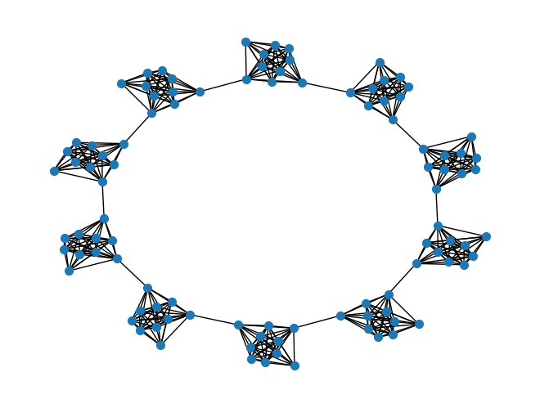
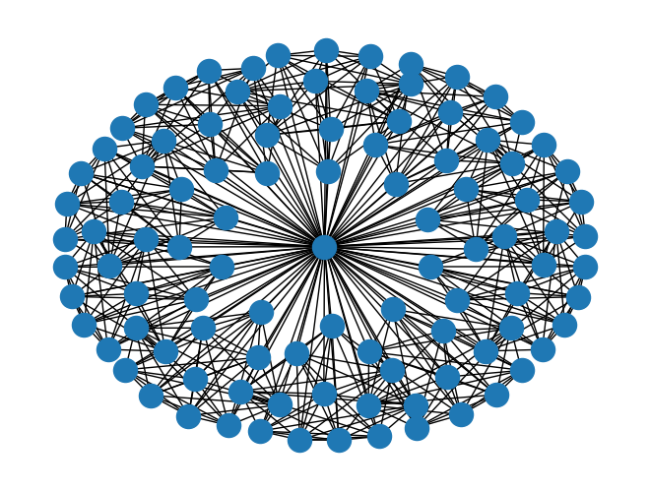
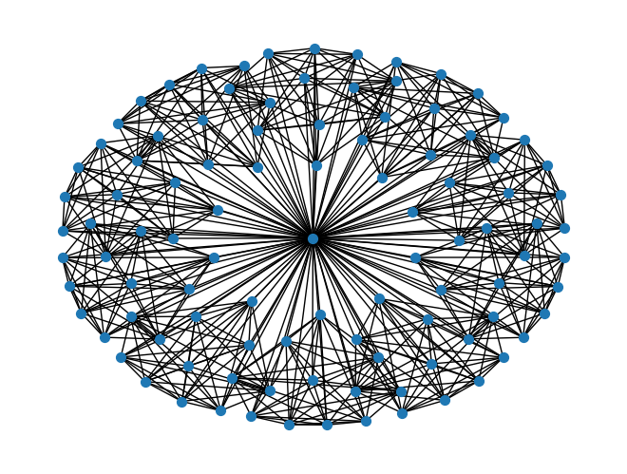
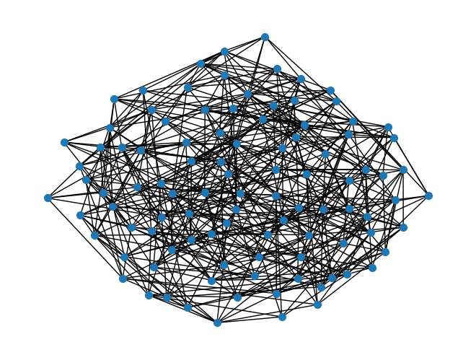
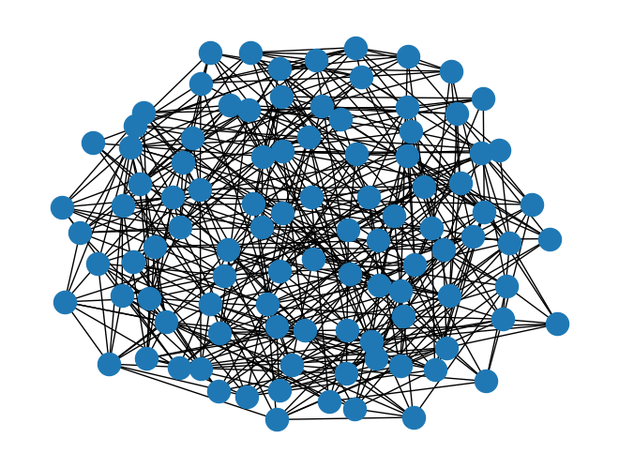
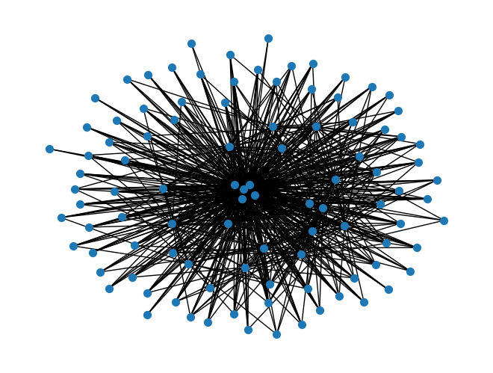
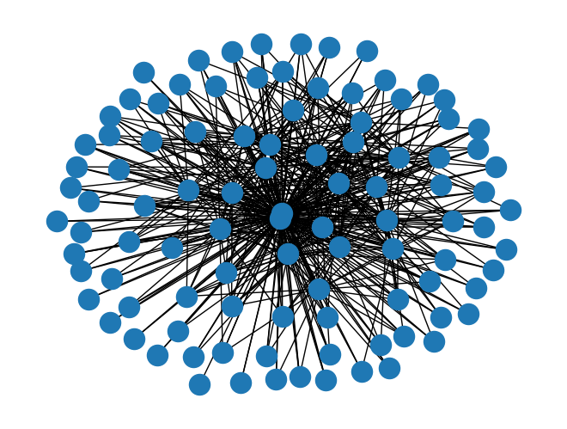
We select representative topologies for 4 "epochs"
pre media
"small
communities"
legacy media
"max centralization"
early internet
"fair distribution of connections"
modern internet
"unequal distribution of connections"

Slide 28
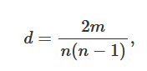
Networks are engineered to have similar densities
Assuming limit on maximum number of connections, based on Prf. Dunbell's work¹.
Density
m=nodes, n=edges
0.09 | 0.11 | 0.10 | 0.11
¹ 3 serious surveys (US and UK) compared. Anecdotal evidence from another 3 countries in the same range. More info in back up slides

Slide 29
Preliminary results

Slide 30
Presentation of results
For every graph type, representing an "epochs", we:
Ran the model for 20-35 steps until results started to saturate as observed in the line plots
Visualized the network graph every step of the way
Generated the phase diagrams correlating pairs of variables from:
Number of initial believers
Number of initial skeptics
Neighbor threshold - I.e. percentage of neighbors that need an opinion for a node to flip
Probability of a susceptible to become infected / skeptical by interacting with one
Phase diagrams: plotted max occurences instead of mean
Notes:
Phase diagrams – looked at the entire range of a variables possible values
Neighbor threshold is

Slide 31
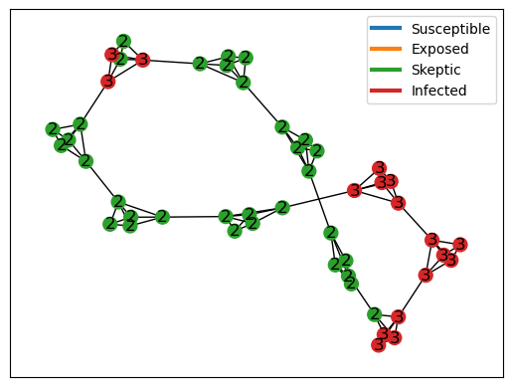
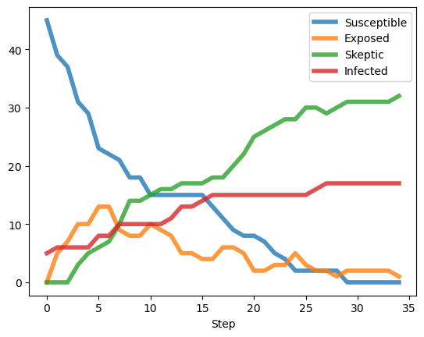
The pre-media era
Modelled as small communities sparsely connected between each other → networkX: CAVEMAN graph model

Slide 32
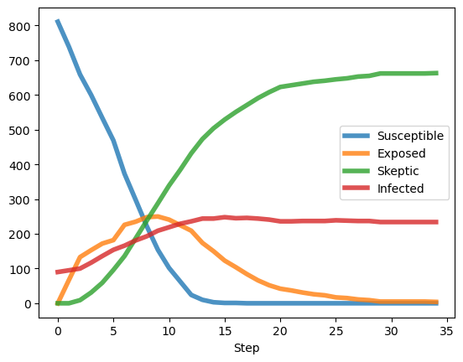
The legacy media era
Modelled by a highly centralized network meant to model a central information entity like television → networkX: WINDMILL graph model
Notes:
In this era, people do not communicate between themselves

Slide 33
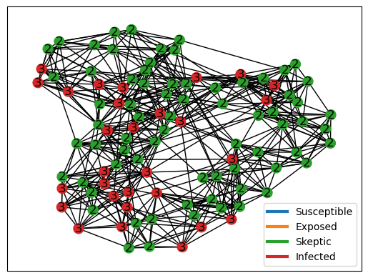
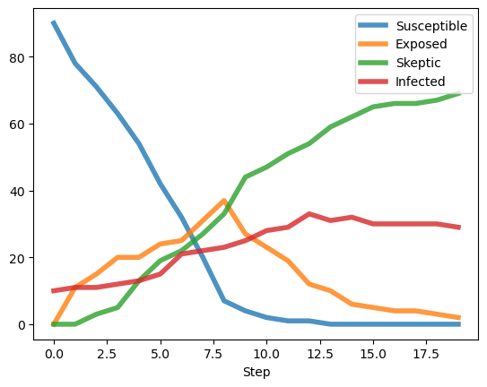
The early-internet era
Modelled as a fair distribution with little clustering and relative closeness between nodes
→ networkX: SMALL WORLD graph model

Slide 34
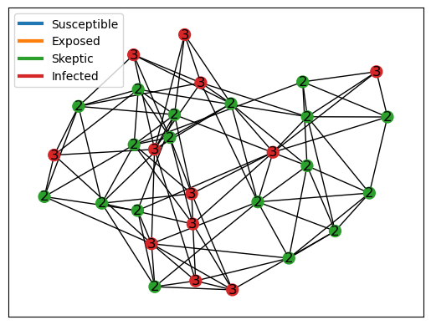
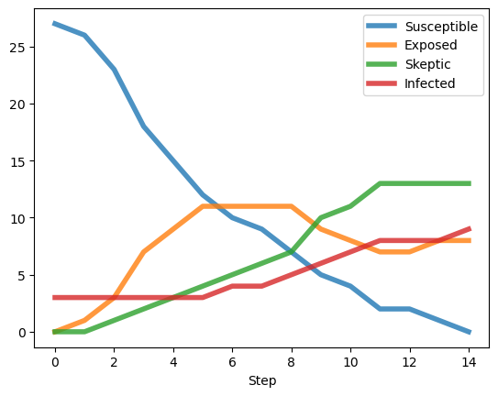
The modern internet era
Modelled with a more unequal number of connections – idea: people are highly connected thanks to the internet but a minority still remain more influencial
Notes:
We observe a longer survival rate of the exposed state – we can preliminarliy conclude that the structure of our current networks today, as much as they are prone to fake news, they are also extremely well connected, and with the presence of a higher amount of initial skeptics, exposed but unifected people remain longer

Slide 35
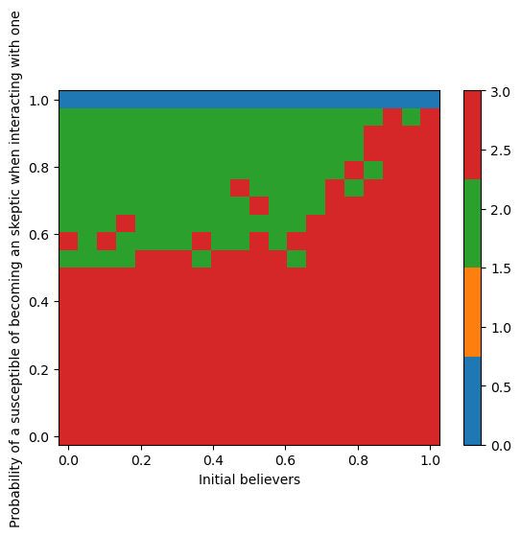
Phase diagrams and takeaways
Notes:
Relaxed caveman

Slide 36

Takeaways – network structure
The network structure has effect in the early stages on the growth of a believer community but little effect on reducing it
Limitations and outlook

Slide 37
Outlook, further work, and considerations

Slide 38
Limitations
No data for probablities of opinion change!
Are our network archtypes representative of the realworld?
Populations are heterogeneous!
(i.e. not everybody is the same)

Slide 39
Remember that rocket guy?
"We used flat Earth as a PR stunt... Flat Earth allowed us to get so much publicity that we kept going!
I know he didn’t believe in flat Earth and it was a schtick.“
Notes:
Maybe we should add or point down at the difference in money between his attempt bf and after involving

Slide 40
Outlook (to-do)
dynamic network
incentive to spread
inhibition of opinion change
after spending money
$$$
Notes:
I somehow really like this colors and that we break the research question in 2.

Slide 41


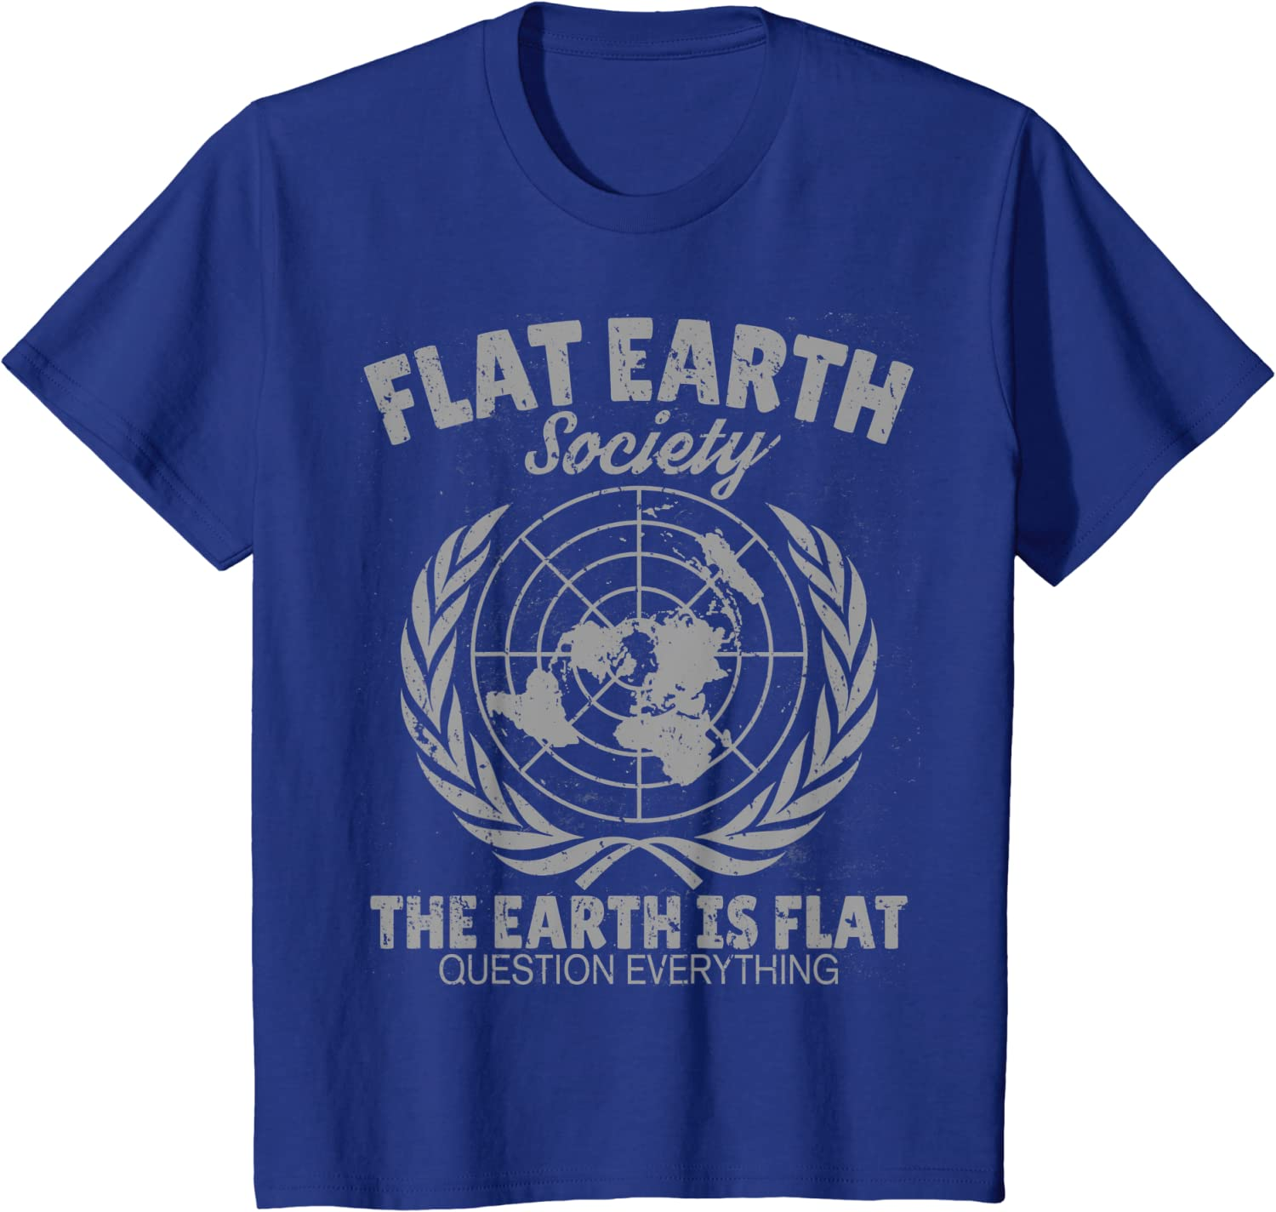
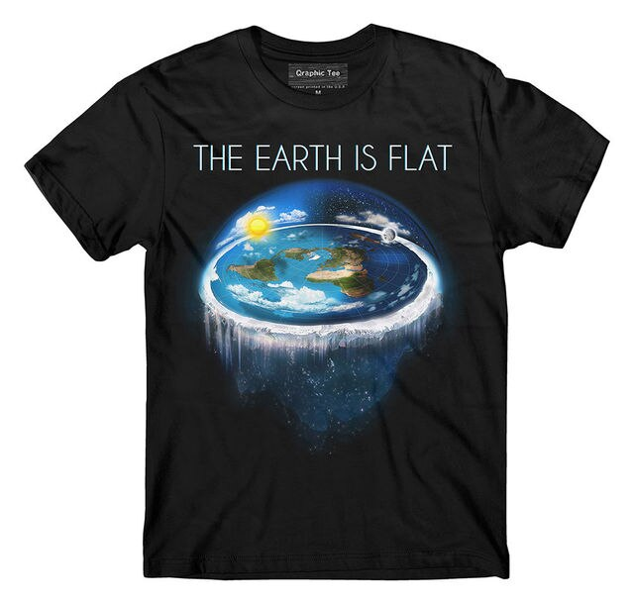
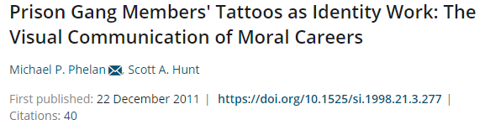
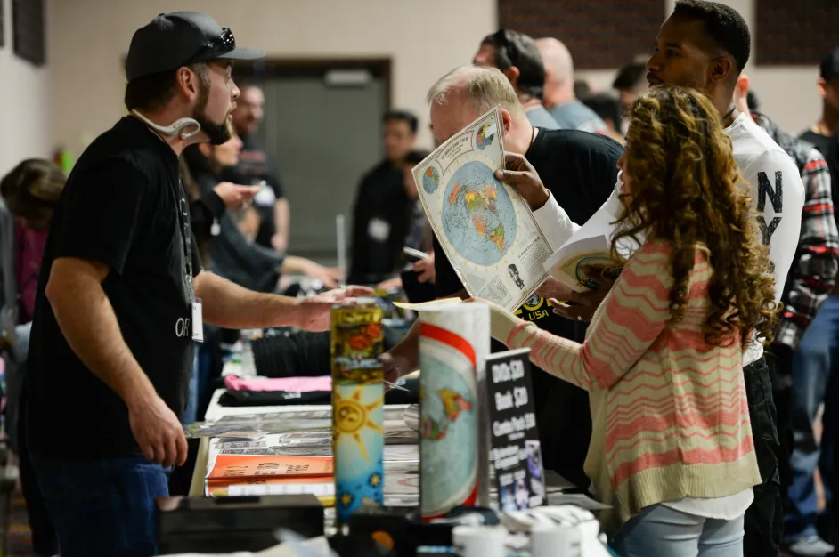
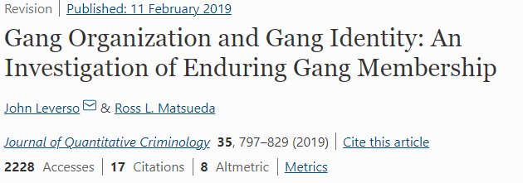
buying merch boosts identity consolidation

Slide 42
buying merch boosts identity consolidation

Slide 43
Research question: Could network structure and money flow jointly cause an increase in conspiracy thinking?
$$$

Slide 44
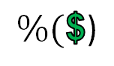
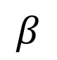
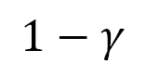




Outlook (to-do)
Susceptible (never heard of it)
Exposed (heard of it, processing)
Infected (believes)
Zkeptic (does not believe)
+ Grifter („infected“, makes money from infected)
G
$
I
$$\%(\text{\$}\text{)}$$
$$β$$
$$β$$
$$1−β$$
S
E
$$1−γ$$
$$γ$$
$$γ$$
Z

Slide 45
Thanks ☺
$$$

Slide 46
Network structure and money flow as drivers of conspiracy thinking
Gent Serifi, Anja Sjöström, Jose Luis Ocana Pujol, Christopher Witzany
05.12.2022

Slide 47
Back up slides

Slide 48
Case study: Flat Earth
Timeline^{1,2}:
Back to mid XIX century England, religious fundamentalists
Flat Earth Society founded in 1971 in California
Society restablished on 2004
First Youtube videos in 2014
Most people in Flat Earth Conferences converted recently by Youtube¹
Different demographics, more sensitive to science-based arguments²
1 Olshansky, A.; Peaslee, R. M.; Landrum, A. R. Flat-Smacked! Converting to Flat Eartherism. Journal of Media and Religion 2020, 19 (2), 46–59. https://doi.org/10.1080/15348423.2020.1774257.
2 Paolillo, J. C. The Flat Earth Phenomenon on YouTube. First Monday 2018. https://doi.org/10.5210/fm.v23i12.8251.
Notes:
I will make the timeline into a nice visual representation later today.

Slide 49
Summary survey results
 | US | US | UK
% agree | 10 | 12 | 3
N (unweighted) | 1134 | 1476 | 2039
Num categories answers | 3 | 4 | 4
Inverse correlation with age? | Yes | Yes | Yes
More extreme than COVID vaccine hessitacy | Yes (microchips) | Yes (harmfull effects not disclosed to the public) | Yes (autism)
Anectotical evidence from Italy and Brazil: 5-8%
https://d25d2506sfb94s.cloudfront.net/cumulus_uploads/document/waya2tqcg8/YG-Archive-ScienceBIANO-110219.pdf​
https://carsey.unh.edu/publication/conspiracy-vs-science-a-survey-of-us-public-beliefs
https://d25d2506sfb94s.cloudfront.net/cumulus_uploads/document/xj7rpmvws8/econTabReport.pdf​
https://www1.folha.uol.com.br/ciencia/2019/07/7-dos-brasileiros-afirmam-que-terra-e-plana-mostra-pesquisa.shtml​
https://www.censis.it/rapporto-annuale/la-societ%C3%A0-irrazionale
Notes:
Disclaimer: there is academic literature doubting that conspiracy theories are now more prevalent: https://journals.plos.org/plosone/article?id=10.1371/journal.pone.0270429

Slide 50
Summary introduction: towards R1
Public perception thinks we live in the golden age of conspiracy theories
Lack of data to support it, academics that examined it claim that there is none. Only looked to the social media era.
Some of this theories are very old (see flat earth) and there are reports that the way people got converted and their motivations are very different.
Our contribution:
“What if the society perception is right, conspiracy theories like flat earth have become more dominant, but it is only visible by comparing different points in history far away enough?”
Notes:
Idea graphically show point 3: preacher pic vs the guy on behind the curve (Netflix), showing the different societies/kinds.
Depends on chris, but I would personally come back to this slide when we introduce our second hypothesis.

Slide 51

Networks are engineered to have the same density, assuming
Clustering coeff
Ask Nino gephy
0.94 | 0.99 | 0.16 | 0.78
0.09 | 0.11 | 0.10 | 0.11
Density
m=nodes, n=edges
Notes:
Fonts need to be fixed!

Slide 52


Dunbar's numbers of social connections
Dunbar, R. I. M. Coevolution of Neocortical Size, Group Size and Language in Humans. Behav Brain Sci 1993, 16 (4), 681–694. https://doi.org/10.1017/S0140525X00032325.

Slide 53
Back up slides

Slide 54
Literature
Paper on whether CT have increased: https://journals.plos.org/plosone/article?id=10.1371/journal.pone.0270429
Paper on Flat-Earth conversion and history:
Flat-Smacked! Converting to Flat Eartherism https://www.tandfonline.com/doi/full/10.1080/15348423.2020.1774257?scroll=top&needAccess=true

Slide 55
Agent based modelling
Self
B
U
D
P
P
B
B
U
B
D
U
P
P
Neighbors
D
B
U
U
D
D
Do we aggregate? I mean, if u have a neighbour who is a beliver and another one who is a disbiliver and u are uncertain, what prob do u have of switching to any of those?
I think on a later stage we need to think about making P not symmetric: that it is not as easy to go in one direction as it is to go in the other one.

Slide 56
Society is:
More connected
More educated
More informed
...than ever.
And still
3-12% of the population believe in flat earth.
Notes:
https://www.sciencealert.com/one-third-millennials-believe-flat-earth-conspiracy-statistics-yougov-debunk
https://carsey.unh.edu/publication/conspiracy-vs-science-a-survey-of-us-public-beliefs
https://www.censis.it/rapporto-annuale/la-societ%C3%A0-irrazionale
https://d25d2506sfb94s.cloudfront.net/cumulus_uploads/document/xj7rpmvws8/econTabReport.pdf

Slide 57
Agent based modelling
agent
properties:
- opinion (believe, disagree, unsure)
actions:
- stochastic opinion change
Step 1
B
D
U
environment
B
U
B
Step 2
there was a paper for this two-time challenge right?
Change to corresponding colors
Notes:
Make point about distinction between environment properties and agent properties.

Slide 58

How to phase diagram
Implementations
Cut off steps for phase diagram
Notes:
Is implementations the right word? Literature?

Slide 59
Agent based modelling
Self
B
U
D
P
P
B
B
U
B
D
U
P
P
Neighbors
D
B
U
U
D
D
Do we aggregate? I mean, if u have a neighbour who is a beliver and another one who is a disbiliver and u are uncertain, what prob do u have of switching to any of those?
I think on a later stage we need to think about making P not symmetric: that it is not as easy to go in one direction as it is to go in the other one.

Slide 60
Jose/history
Slides for comments, that are not intended to be included in final presentation
From now on: slide structure that we agreed on, following the “history” approach
Structure:
Introductionn/Setting the story line
Explaining our model: SEIZ/different network topologies
Preliminary results: network topologies reassembling historical periods
Outlook: go back to rocket guy, money and more
After that there is space for back up slides.
After that a dummy webpage with the links. I will put everything in bibtex/overleaf after the presentation. Please put ur papers/links there too.

